Slide 1
MEC101
Mechanical Sciences-I
Chapter 3
Transformation of
Stresses and Strains

Slide 2
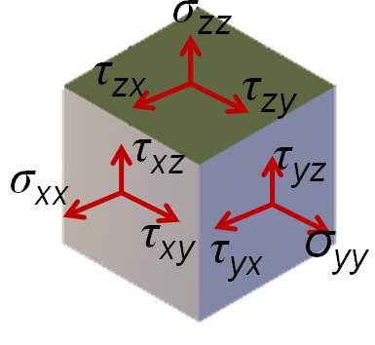
Stresses: Sign Convention
The sign of a stress component depends on the direction of normal and the direction of force: If both have same sign then the stress component is positive, if the two have different signs, then the stress component is negative.
z
x
y

Slide 3
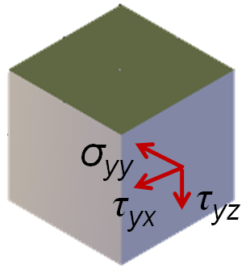
Stress: Sign Convention...
σ_{yy} is negative
τ_{yx} is positive
τ_{yz} is negative
z
x
y

Slide 4
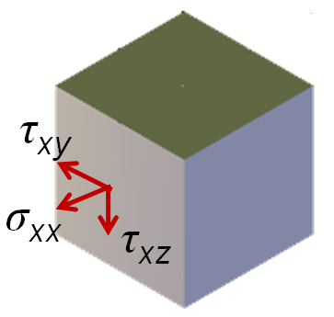
Stress: Sign Convention...
σ_{xx} is positive
τ_{xy} is negative
τ_{xz} is negative
z
x
y

Slide 5

Stresses on Inclined Plane
P
P
θ
●
n
Normal Force = Pcosθ
A
P
θ
P
Tangential Force = Psinθ
B
Normal stress = Force/area
= Pcosθ/(A/cosθ)
= Pcos²θ/A
Shear Stress = Pcosθsinθ/A

Slide 6
Two-Dimensional Stress
σ_{yy}
τ_{yx}
τ_{xy}
δy
σ_{xx}
σ_{xx}
τ_{xy}
δx
τ_{yx}
y
σ_{yy}
x

Slide 7

Two-Dimensional Stress
σ_{yy}
τ_{yx}
First convert stresses in to forces since ≡m is of forces not stresses.
Take depth = 1
τ_{xy}
δy
σ_{xx}
σ_{xx}
τ_{xy}
δx
τ_{yx}
σ_{yy}
y
x

Slide 8
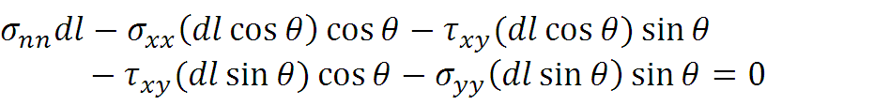
Stresses on θ Plane
τ_{nt}
σ_{nn}
σ_{xx}
n
θ
τ_{xy}
τ_{xy}
σ_{yy}
+

Slide 9

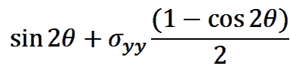

Stresses on θ Plane...
τ_{nt}
σ_{nn}
σ_{xx}
θ
τ_{xy}
τ_{xy}
σ_{yy}
+
+τ_{xy}

Slide 10

Stresses on θ Plane...
τ_{nt}
σ_{nn}
σ_{xx}
θ
τ_{xy}
τ_{xy}
σ_{yy}

Slide 11
Stresses on θ Plane...
τ_{nt}
σ_{nn}
σ_{xx}
θ
τ_{xy}
τ_{xy}
σ_{yy}
+τ_{xy}

Slide 12



Stresses on θ Plane...
τ
n
●
If τ_{xy} = 0
2θ
σ
●
n'

Slide 13

Stresses on θ Plane...
τ
●
Y
If τ_{xy} ≠ 0
σ
●
X

Slide 14
Stresses on θ Plane...
●
τ
Y
●
If τ_{xy} ≠ 0
2θ
σ
2θ
N
●
●
X

Slide 15
Stresses on θ Plane...
y
y
B
A
x
x
●
τ
Y
●
B
2θ
σ
2θ
A
●
●
X

Slide 16
Principal Planes
y
τ
●
Y
x
B
σ
A
B
●
●
A
θ
2θ
●
X

Slide 17
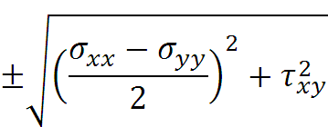
Principal Planes/ Principal Stresses
σ_{A,B} =
τ
●
Y
σ
B
●
●
A
2θ
●
X

Slide 18
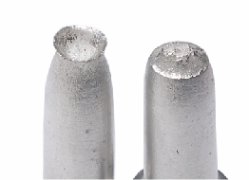
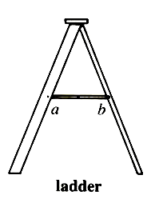
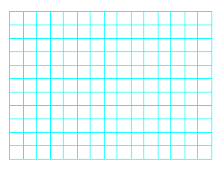
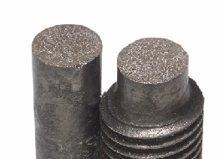
Uni-axial Tension
σ_{xx}
τ
C
Shear Failure
●
●
●
σ
Y
X
●
D
Brittle Failure

Slide 19
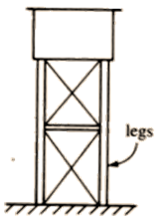
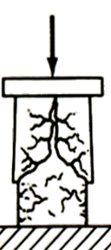
Uni-axial Compression
σ_{yy}
τ
●
C
●
●
σ
Y
X
●
D

Slide 20
Hydrostatic Loading
σ₁
σ₁
τ
●
No shear
Compressive stress independent of direction
X,Y
σ

Slide 21
Equal Tensile Loading
σ₁
σ₁
τ
●
No shear
Tensile stress independent of direction
X,Y
σ

Slide 22
Shear Loading
y
2
1
τ_{o}
x
τ
Principal Directions
Y
●
2●
●1
σ
●
X

Slide 23
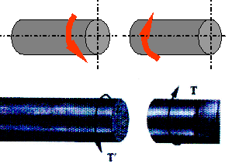
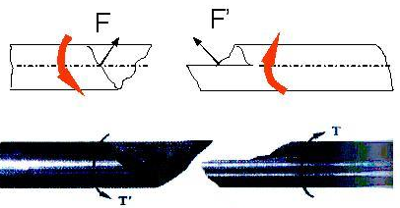
Shear Failure
y
2
1
τ_{o}
x
Principal Directions
Torsion failure of a ductile material
Torsion failure of a brittle material

Slide 24



Transformation of Strains
-

Slide 25

Mohr Circle of Strain
y
γ/2
●
Y
x
B
A
ε
θ
ε_{xx}
ε_{yy}
γ_{xy}/2
●
X

Slide 26
Principal Planes
y
γ/2
●
Y
x
B
●
B
A
ε
θ
ε_{xx}
ε_{yy}
●
A
2θ
τ_{xy}/2
●
X

Slide 27
Shear Loading
y
2
1
x
γ/2
Principal Directions
Y
●
No shear strain in these directions
2●
●1
ε
●
X

Slide 28
An Example:
In a condition of plane stress in a steel plate, σ_{xx} = 130 MPa, σ_{yy} = -70 MPa, τ_{xy}= 80 MPa, Find the principal strains.
τ
y
Y
●
x
Radius = sqrt(100² + 80²)
= 128
σ
30
σ₁ = 30 + 128 = 158 MPa
σ₂ = 30 - 128 = -98 MPa
●
X

Slide 29
Another Example:
In the last example:
σ₁ = 158 MPa
σ₂ = -98 MPa
Find principal strains
ε₁ = (σ₁ –νσ₂)/E = (158 – 0.25×(-98))/200×10³ = 0.9×10⁻³
ε₂ = (σ₂ –νσ₁)/E = (-98 – 0.25×(158))/200×10³ = - 0.69×10⁻³

Slide 30
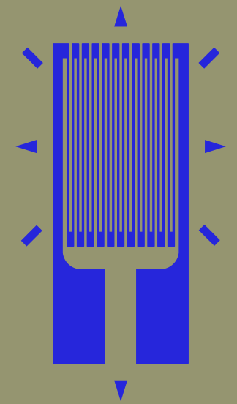
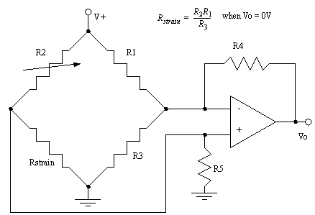
Bonded Resistance Strain Gauges
Axis
Terminals

Slide 31
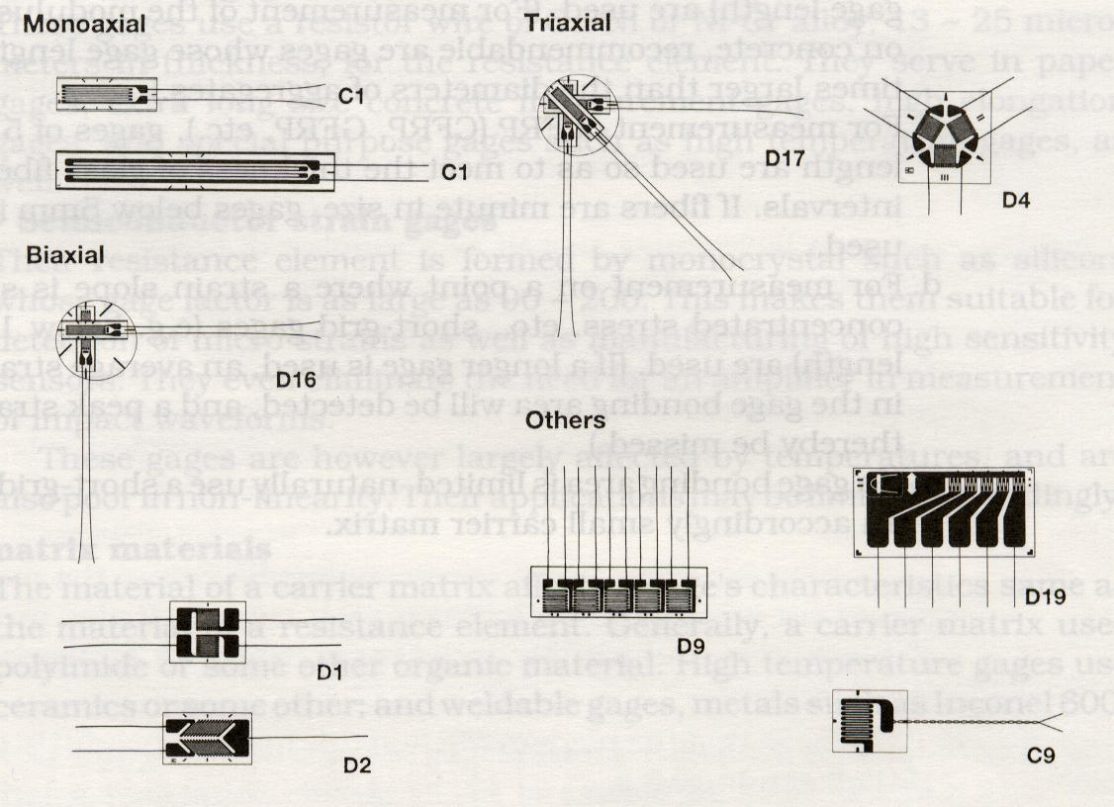
Bonded Resistance Strain Gauges

